Slide 1


Histopathological Classification
Joanna Wiekiera, Martyna Żur

Slide 2

INPUT DATA
Aim of this project is to distinguish five classes:
colon adenocarcinoma
colon benign tissue
lung adenocarcinoma
lung benign tissue
lung squamous cell carcinoma

Slide 3
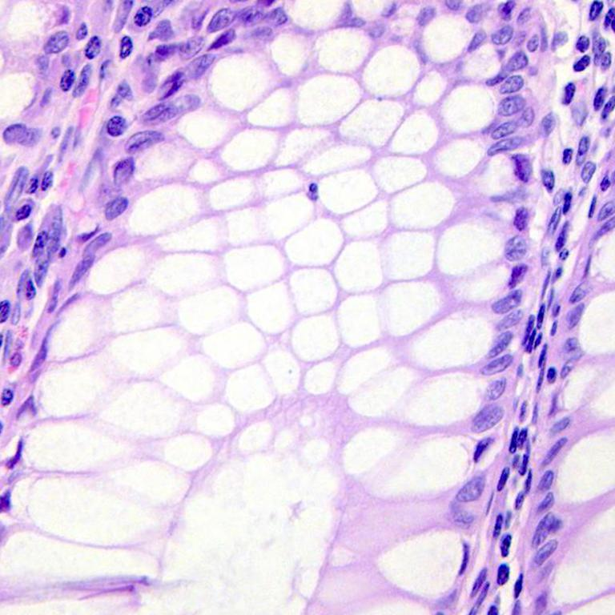
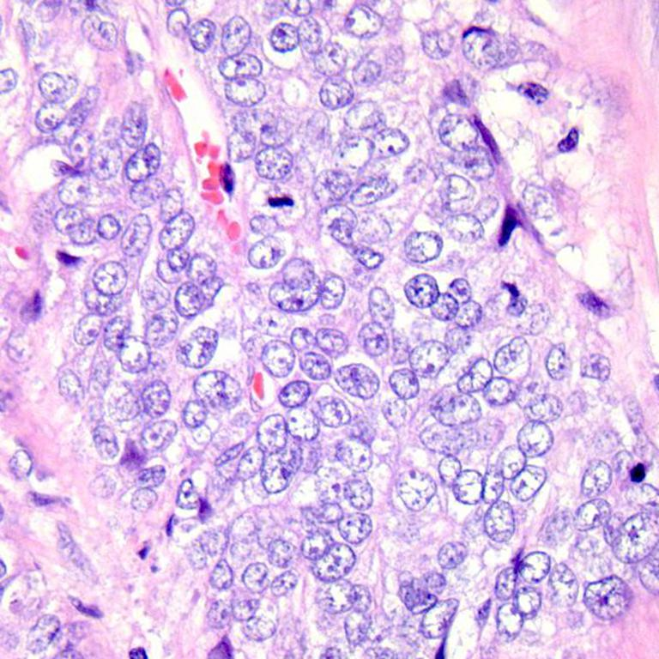
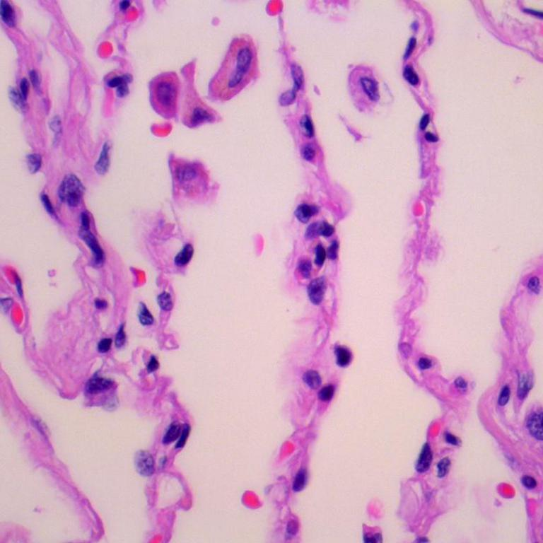
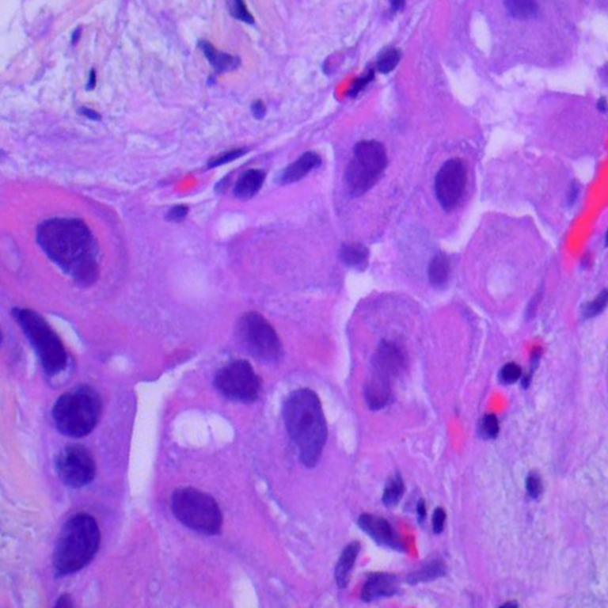
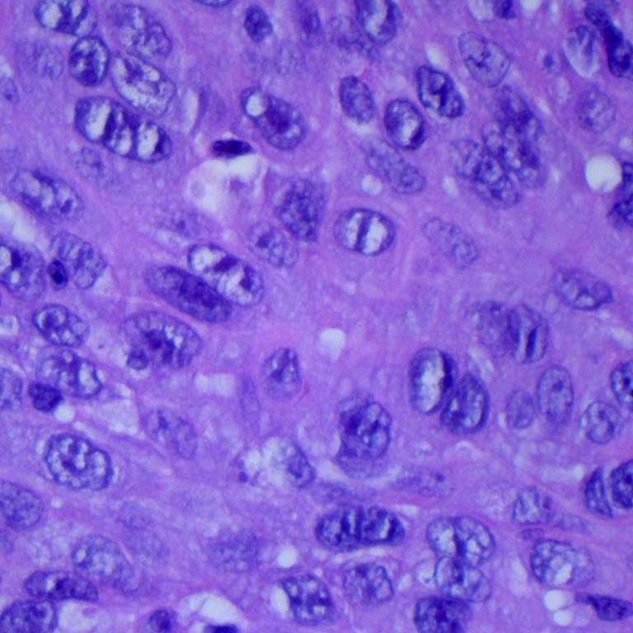
INPUT DATA
Aim of this project is to distinguish five classes:
colon adenocarcinoma
colon benign tissue
lung adenocarcinoma
lung benign tissue
lung squamous cell carcinoma
(1) colon benign tissue
(2) colon adenocarcinoma
(3) lung benign tissue
(4) lung adenocarcinoma
(5) lung squamous cell carcinoma

Slide 4
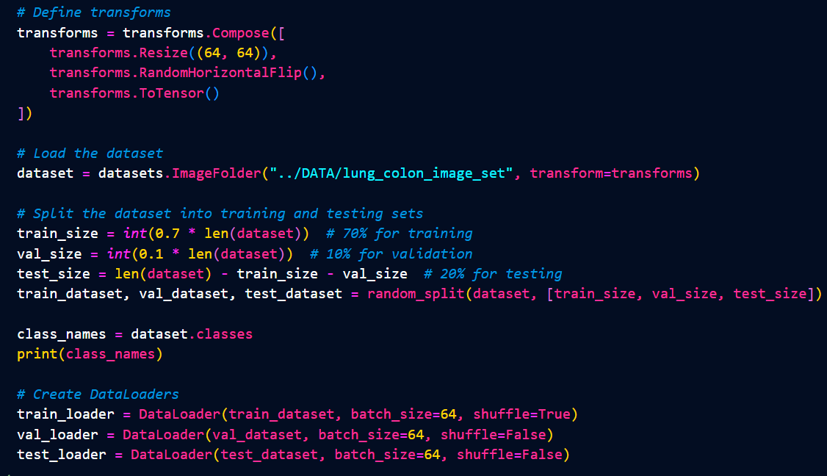
DATA PREPROCESING

Slide 5
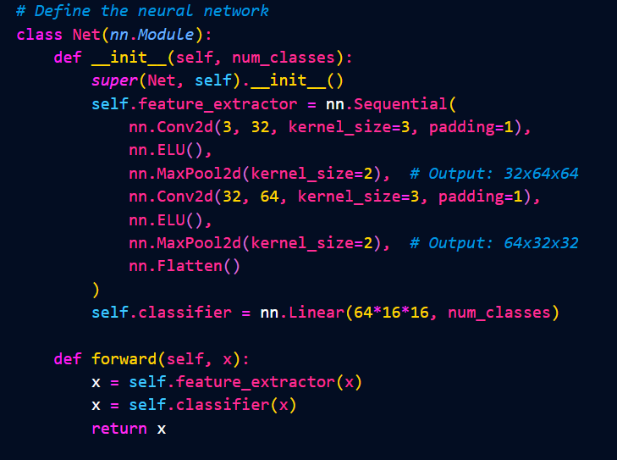
(1)
CONVOLUTIONAL NEURAL NETWORK
(1)

Slide 6
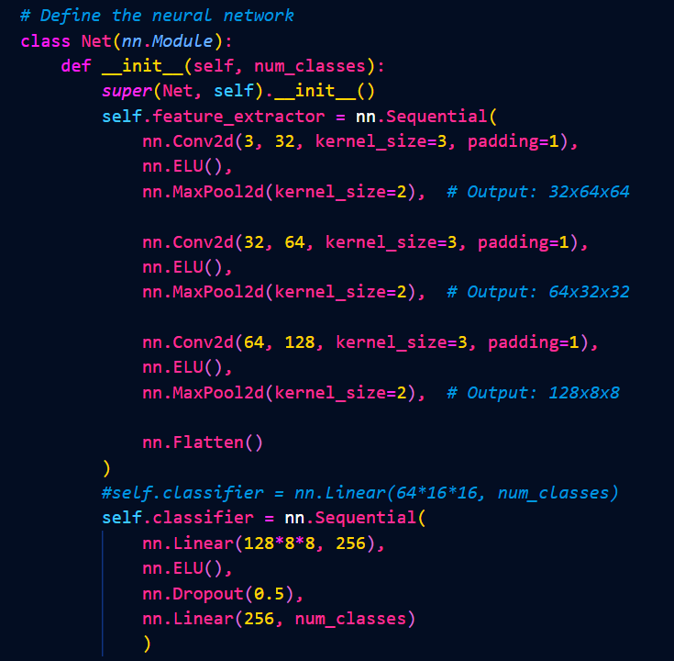
CONVOLUTIONAL NEURAL NETWORK
(2)

Slide 7
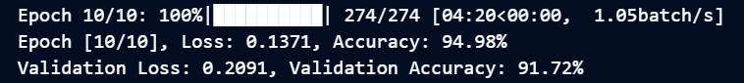
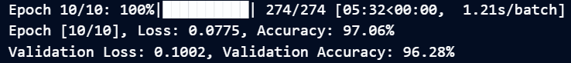


CONVOLUTIONAL NEURAL NETWORK
(3)

Slide 8
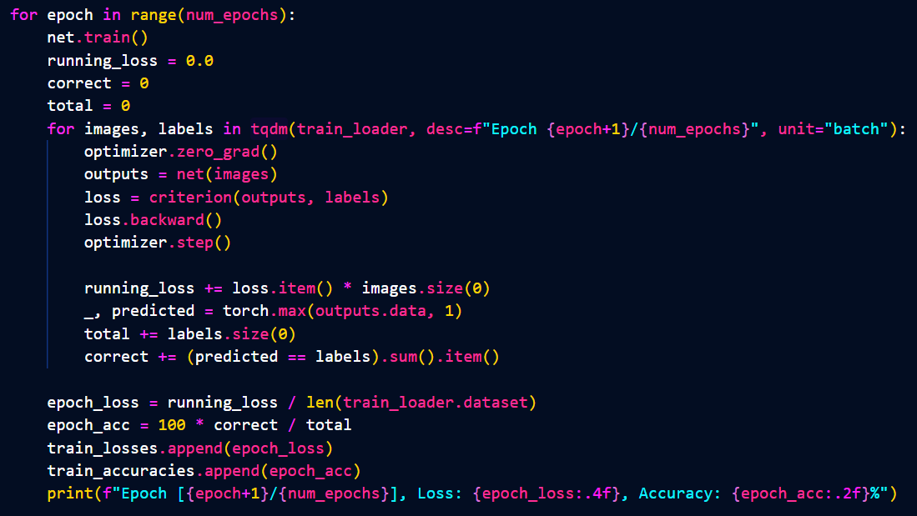
TRAINING LOOP (traning)

Slide 9
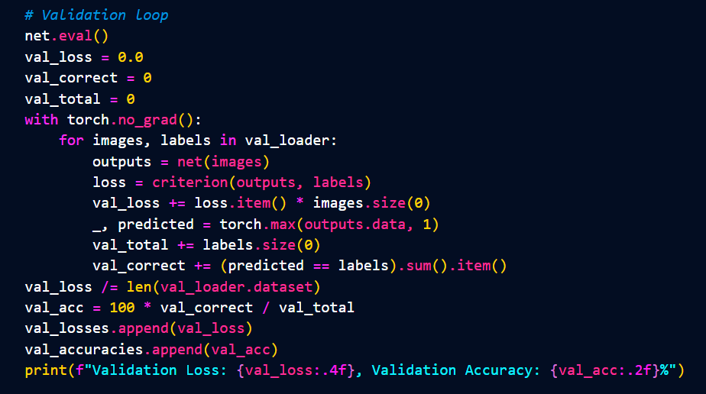
TRAINING LOOP (validation)

Slide 10
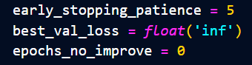
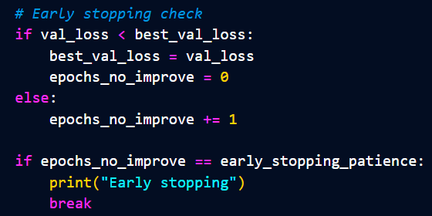
TRAINING LOOP (early stopping)

Slide 11
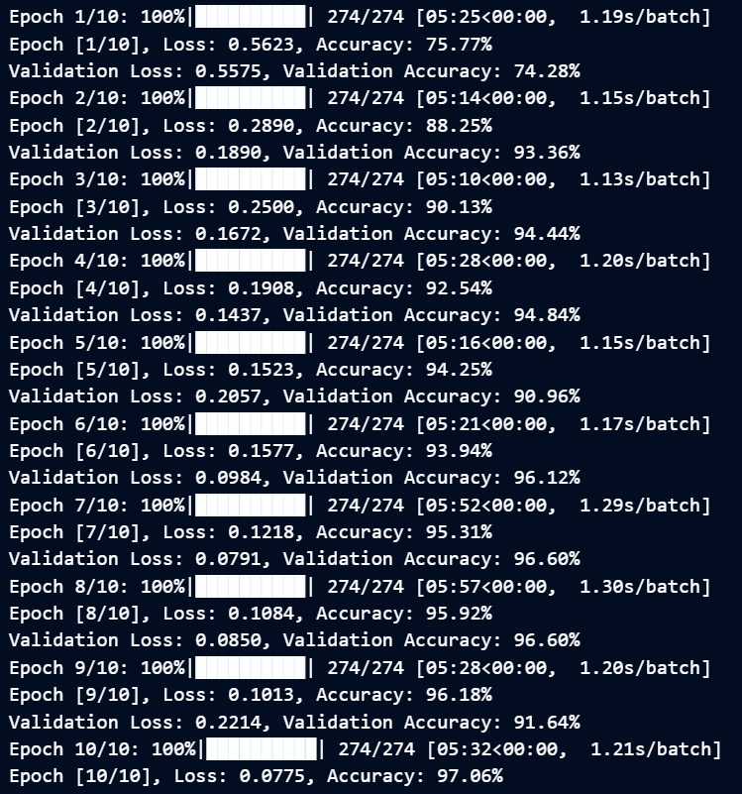
RESULT
(tqdm)

Slide 12
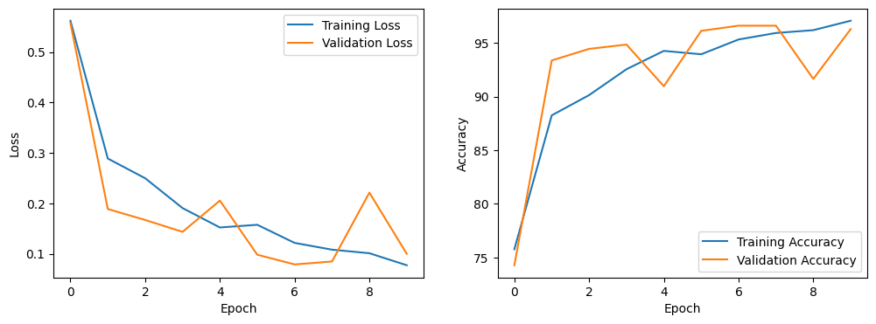
RESULT (plots)

Slide 13
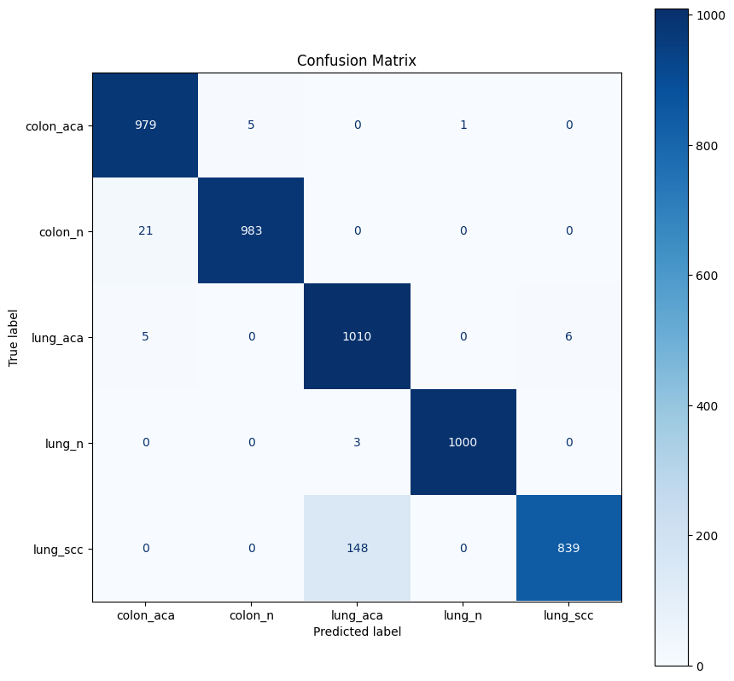
RESULT
(confusion matrix)

Slide 14
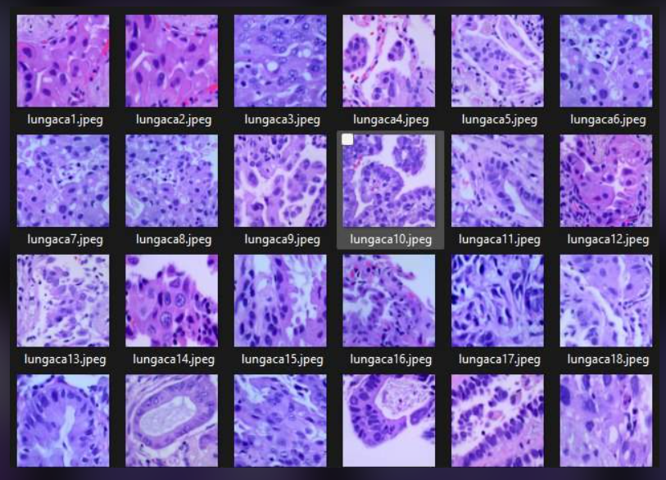

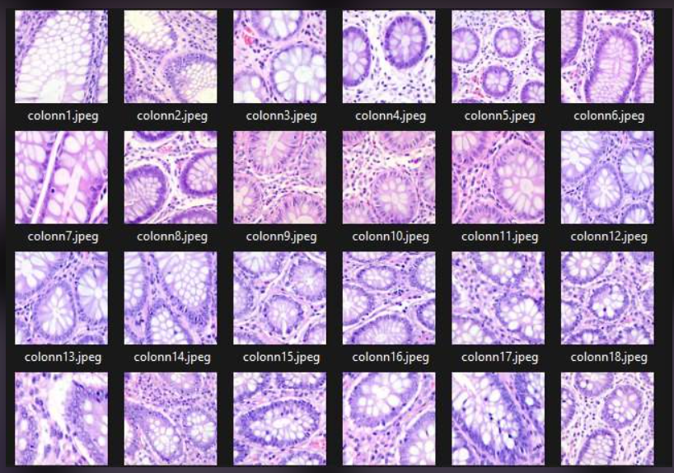
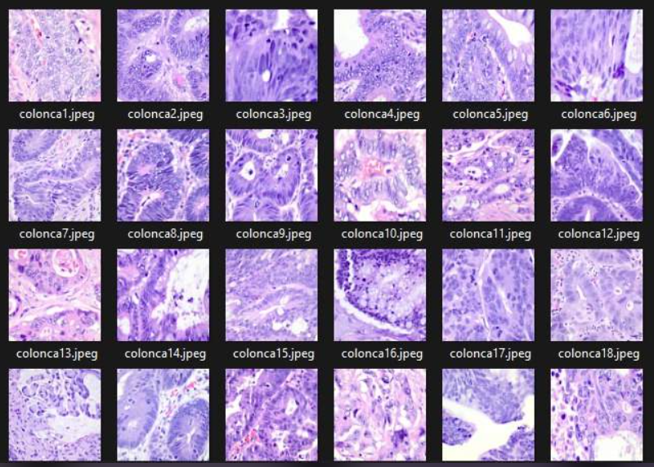
CONCLUSION
OUR DATE:
Training loss
Validation loss

Slide 15
Histopathological Classification
Joanna Wiekiera, Martyna Żur

